Slide 1


Office TPM
Awareness Training Programme

Slide 2
Key Issues
Production
Stoppage
Payment
Default
High
Inventory
Why
Office TPM ?
Procedural
troubles
No Synchronization
of function
No Work
Procedures

Slide 3
Status of Office Functioning
High Level of paper work
Delay in retrieval of paper and information
Electronic media not fully utilized
Less focus on inventory control
Production Stoppages due to want of raw material
spares and consumables.

Slide 4
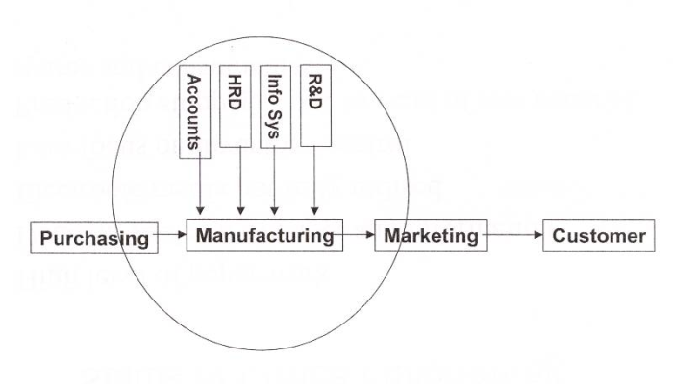
Organization Set Up
Support functions for the Manufacturing

Slide 5
Supportive Functions of Office TPM
Supply Chain
Management
Quick MIS
Support To
Prod. Function
Support To
Maint.
Function
Internal
Office
TPM
Customers
External
Customers
Govt. Agencies
Suppliers
Stake Holders
Customers

Slide 6
Aim
To understand the relationship of office activity and production activity and achieve customer delight & zero functional losses by creation of efficient office functions.

Slide 7
Relation between Production activity & Office activity
Continuously improving Productivity, Efficiency in the Administrative functions.
Identify & eliminate losses.
Reduce costs
Improve office working environment.
Raw materials
Raw data
Machines
Processing
Product
Information
Manufacturing
VS
Office

Slide 8
Office Objective
P - Reduction in document retrieval time, overtime hours per person, accounts closing time, Increase in payment efficiency, office equipment breakdown.
Q – Eliminating Customer complaint due to logistics.
C - Reduction in logistics cost, Raw Material Inventory, , Expenses on premium freight for dispatch & purchase.
D - Increase in dispatch efficiency, Delay in payments to suppliers & delay in information.
S – Safety in material handling stores / logistics, Safety of soft & hard data.
M - Number of KAIZENS implemented in office area.

Slide 9
Office Targets - Example
Sr. no | Parameters | Unit | Benchmark | Target
1 | File/ Document retrieval time | Seconds
2 | Inventory | No. of Days
3 | Line stoppages Incidences ( In-house / customer) | Nos
4 | Raw material cost reduction | %
5 | Packaging cost reduction | %
6 | Logistic cost reduction | %

Slide 10
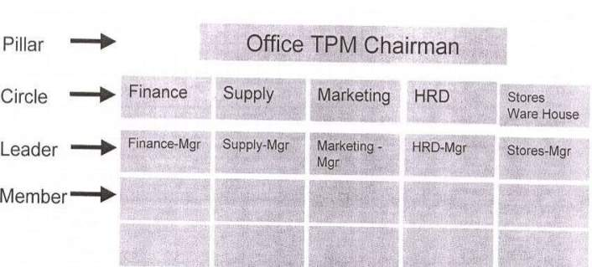
Organization Chart – OTPM Subcommittee
After TPM KICK OFF, activate 4 pillars ( JH,PM,QM,KK), Start office TPM activity by forming subcommittee.
Subcommittee should be head by a senior person from one of the support functions eg. Head of Finance , MIS , Purchase etc,

Slide 11
Master Plan
OTPM awareness program
Formation of sub committee
Formation of OTPM circles
Training of circle leaders / members
Jishu Hozen ( 1s,2s,Audit,3s).
Kaizen Activities
Standardization (Visual Control & Visual management)
Autonomous Management

Slide 12
The Three Pillar Approach in OTPM
Jishu Hozen
  Seven steps of Jishu Hozen
Kobetsu Kaizen
  Reduction in losses
Education and training

Slide 13
Office Area : 1S,2S & 3S Concept
1 .Seiri – Sort : Eliminating unnecessary items from the work place.
I shall remove all items from the work place that are not needed for current production or clerical operations.
2 . Set in order – Seiton : Efficient & Effective storage method.
I shall arrange needed items so that they are easy to use and labeling them so that they are easy to find and put away.
3 . Shine – Seiso :
I shall ensure that my work place , floor , machine and equipments are clean & tidy always. I shall keep my surrounding area clean & tidy.

Slide 14
1S,2S,3S in Office Area
1S
2S
3S
Initial Clean Up
Sort out wanted
From unwanted
Dispose Unwanted
Clean dirt , stains
& Dust , Remove
Dents and repair
damage
Systematic Arrangement
identify all required Files/ Items With a Code
Identify all locations
Assign each identified item to an identified storage location
List them for easy reference & retrieval
Ensure Adequacy of facilities for storage
Maintain Easy to retrieve storage system
Periodical audit to sustain
Shine The Place
Evolve Standards
For Cleaning
Ensure Adherence to standards
Maintain Spic & span and spotless work station
-File Retrieval in 30 Seconds
-Cleaner and comfortable office ambience.

Slide 15
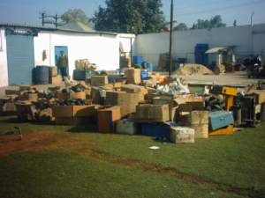
Using red tag campaigns
1S Examples
RED TAG
 | Category | Raw Material Equipment Tools Other …
 | Item Name | Imperial Die set
 | ID Code | 123abc
 | Dept/cell | Lock set cell
 | Date in
 | Name
 | …
 | …

Slide 16
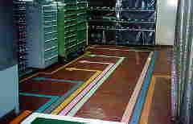
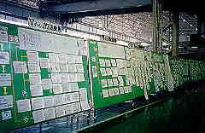
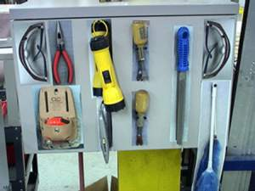
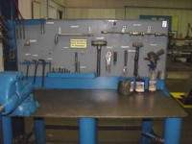
2S Examples
Location identification
Visual display
Shadow boards for tool
Work table

Slide 17
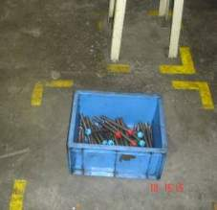
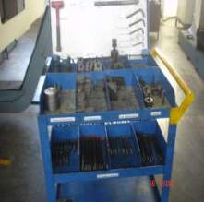
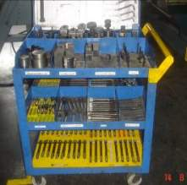
1S,2S in Shop Floor
BEFORE
AFTER 1
AFTER 2
Allen bolts are in mixed condition, kept in bins
New trolley made to keep the allen bolts.
Specific locations provided for allen bolts with color code.
Benefit:- Searching time reduced from 2 min to 30 Sec.

Slide 18
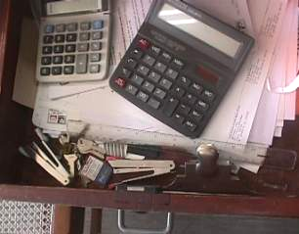
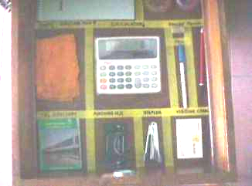
2S Example in Office
Systematic Arrangement
ITEMS IN USE KEPT IN ORDER
PLACE FOR EVERY THING &
EVERY THING IN ITS PLACE
LOCATION IDENTIFIED
NO IRRELEVANT MATERIALS
VISIBLE CONTROL

Slide 19
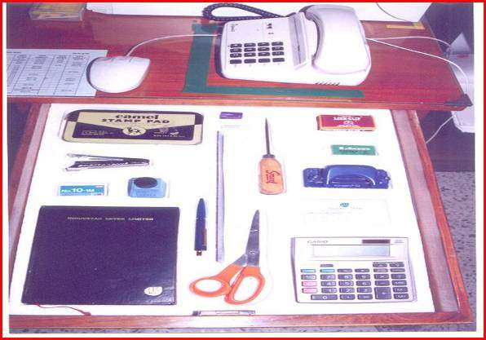
2S Example in Office

Slide 20
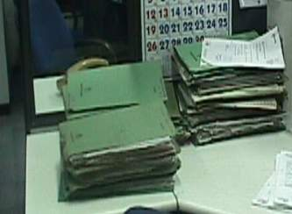
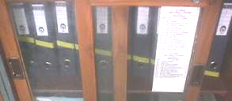
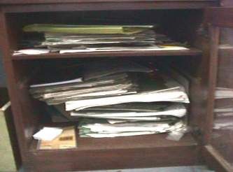
2S Example in Office

Slide 21
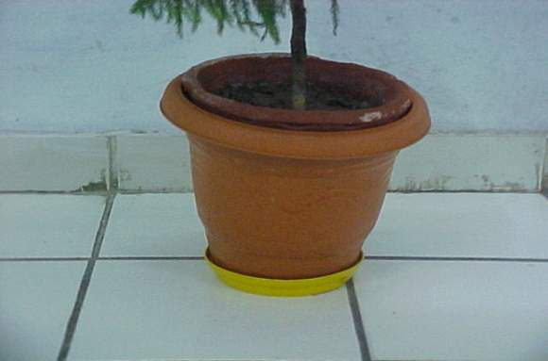
2S Example in Office

Slide 22
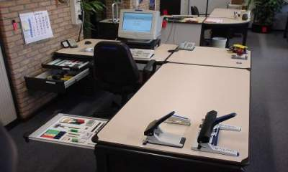
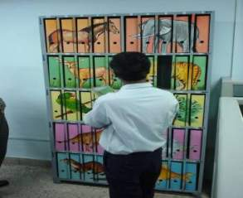
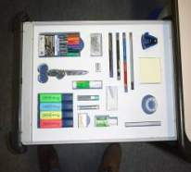
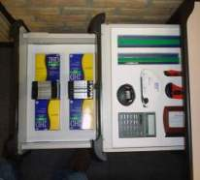
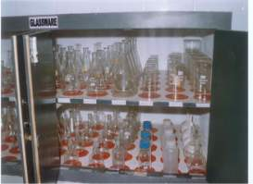
1S,2S in Office

Slide 23
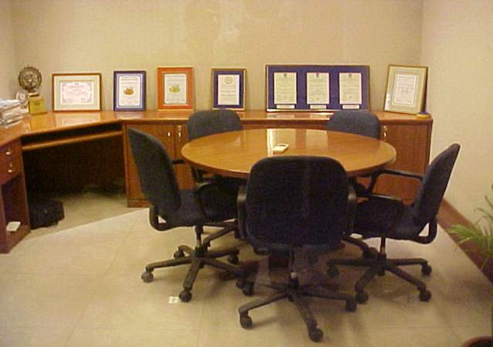
1S,2S in Office

Slide 24
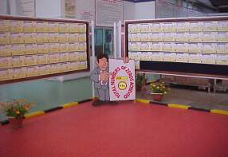
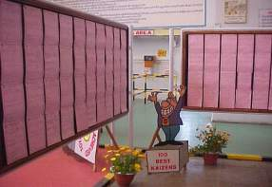
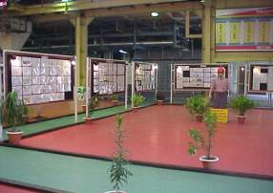
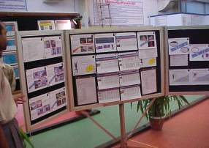
1S,2S in Office

Slide 25
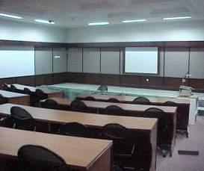
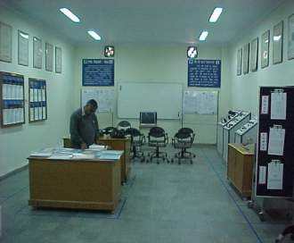
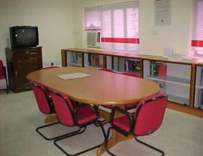
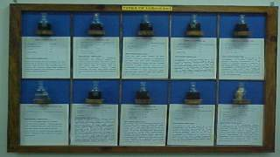
1S,2S in Office

Slide 26
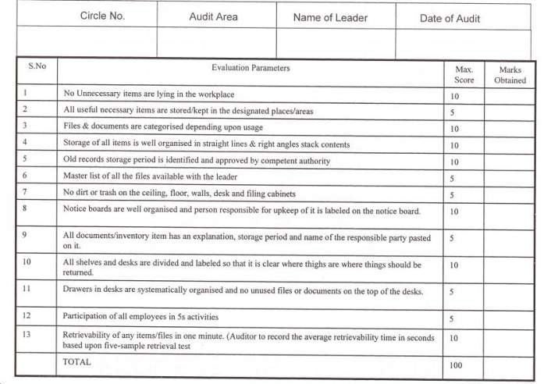
1S,2S Audit Sheet

Slide 27
JISHU HOZEN ACTIVITIES
(AUTONOMOUS MAINTENANCE)
IN OFFICE AREA

Slide 28
Seven Steps Of Autonomous Maintenance
1. Initial Cleaning
2. Counter measure against source of contamination and inaccessible area
(Computer , table , Xerox , machines etc .)
3. Formulation of cleaning standards.
4. Visual management and visual controls (for files, floor areas and office equipment)
5. General office area inspection (use check sheet)
6. Systematic Autonomous Maintenance (Orderliness and Tidiness)
7. Practice Self-Management

Slide 29
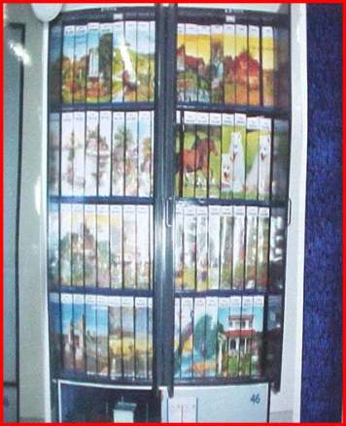
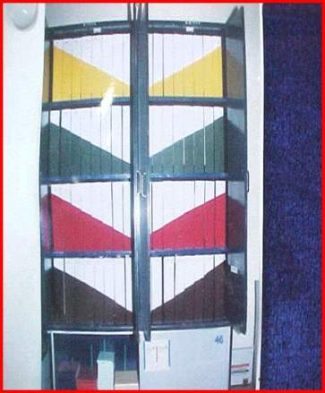
Visual Control in office

Slide 30
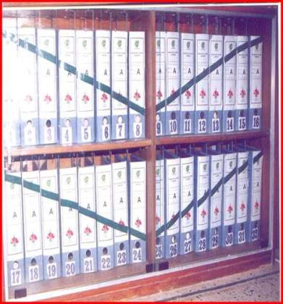
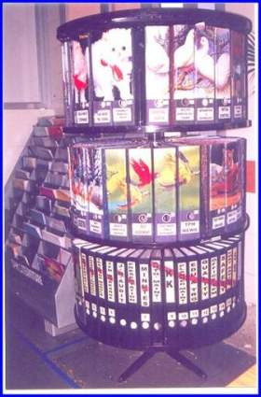
Visual Control in office
Retrieval time should be 30 Secs

Slide 31
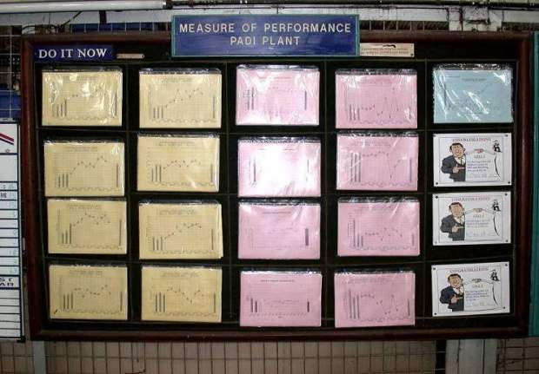
Visual Control in office for Communication
Measure of Performance
MOP Graphs for Quality, Cost, Delivery

Slide 32
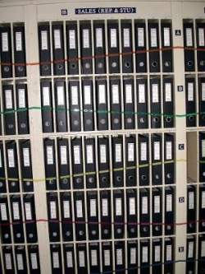
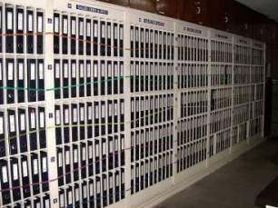
Visual Control in office for Files
Visualisation in Office areas
File arrangement system in Office area

Slide 33
KOBETSU KAIZEN ACTIVITIES
(INDIVIDUAL IMPROVEMENT )
IN OFFICE AREA

Slide 34
Kobetsu Kaizen in Office Area
To concentrate on administrative hidden losses
To coordinate with all agencies like Shop floor person, suppliers, customers, employees so on..
To be innovative in their approach, optimization of cost, time & smooth work flow.
Steps to achieve improvements:
Selection Of topic
Analyze the causes
Planning for improvement
Implementation
Result
Review / consolidation.

Slide 35
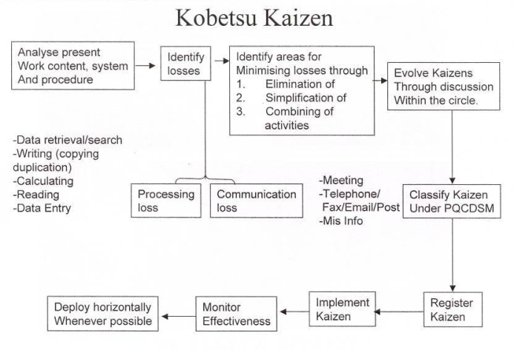
Kobetsu Kaizen in Office Area

Slide 36
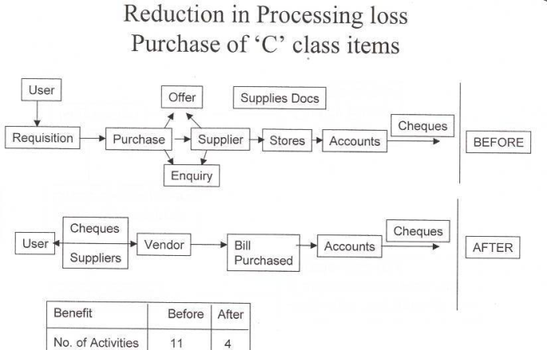
Reduction in Processing Loss

Slide 37
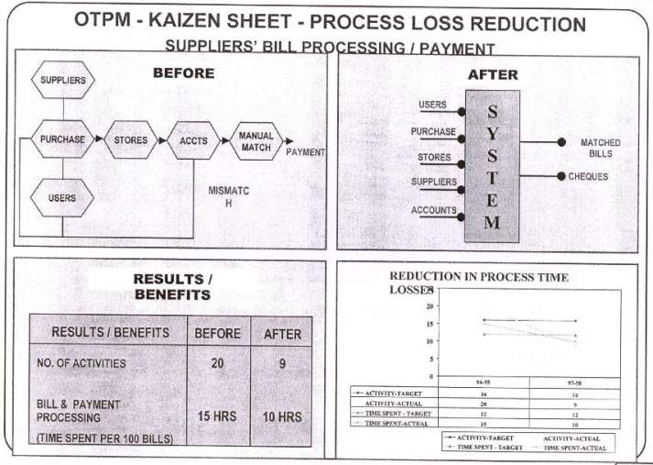
OTPM Kaizen- Example

Slide 38
Approach in – Reduction in Raw material cost
Imported
Further source wise
Grade wise
Data Analysis
Alternative source /
Grade development
- Cost Based
- Quality Based
- Service Based
Negotiation

Slide 39
Approach in – Reducing Inventory , Raw Materials
Take stock of
Existing materials
Classify as usable
Slow / non moving
Usable Material
Consume
Transfer to other unit
Disposal
Slow / Non Moving Material
Convert to make it usable
Disposal

Slide 40
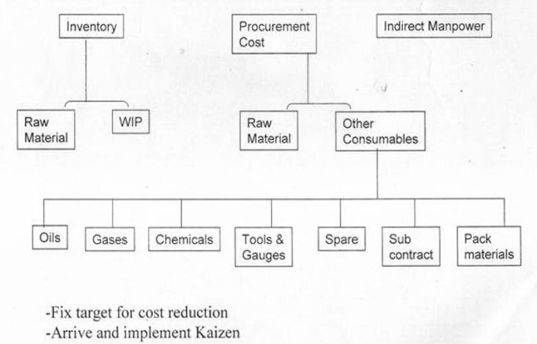
Cost Reduction

Slide 41
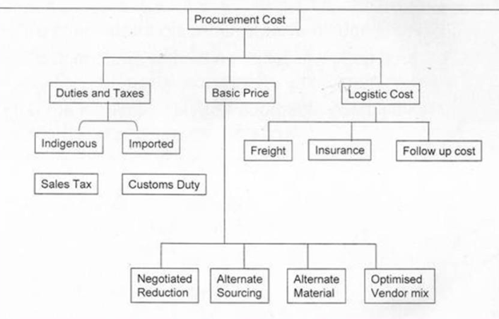
Procurement Cost Reduction

Slide 42
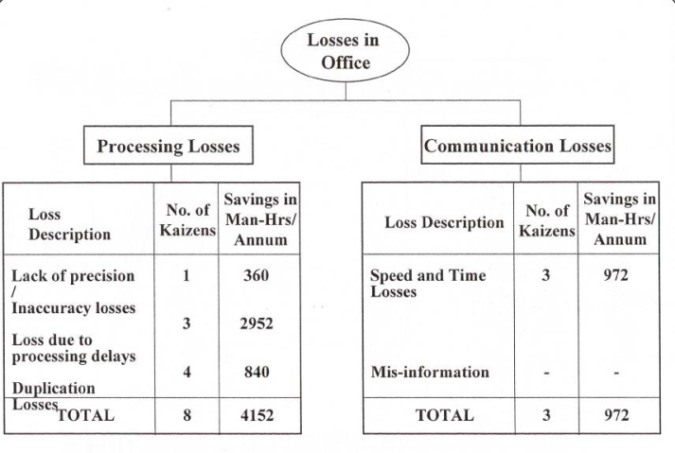
Losses Example

Slide 43
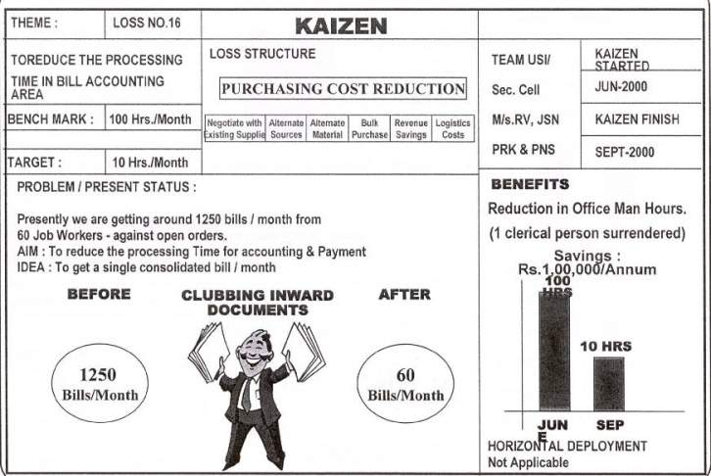
OTPM Kaizen- Example

Slide 44
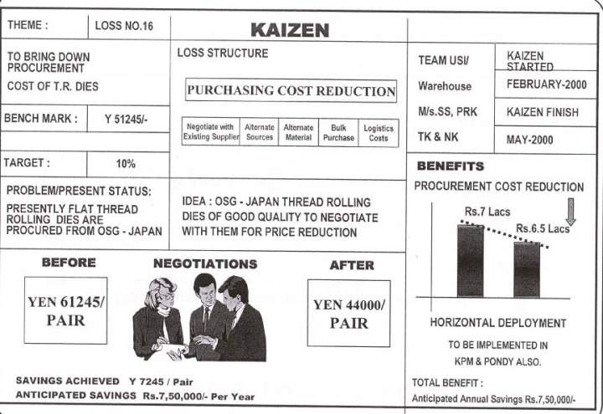
OTPM Kaizen- Example

Slide 45
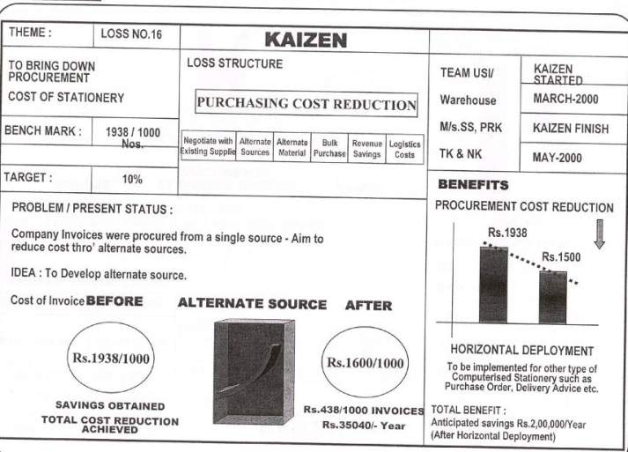
OTPM Kaizen- Example

Slide 46
THANK YOU

